Slide 1
Zones of regulation

Slide 2
Zones of Regulation
The Zones of Regulation is a framework, created by Leah Kuypers designed to “foster regulation and emotional control.”
The programme aims to teach children about self-regulation by categorising all the different ways we feel and states of alertness we experience into four coloured zones.
The framework provides strategies to teach pupils to become more aware of and independent in controlling their emotions and impulses, manage their sensory needs, and improve their ability to problem solve conflicts.
Recommended and used by teams supporting SALT and C&I but, as you will see is increasingly a valuable approach for all children and young people

Slide 3
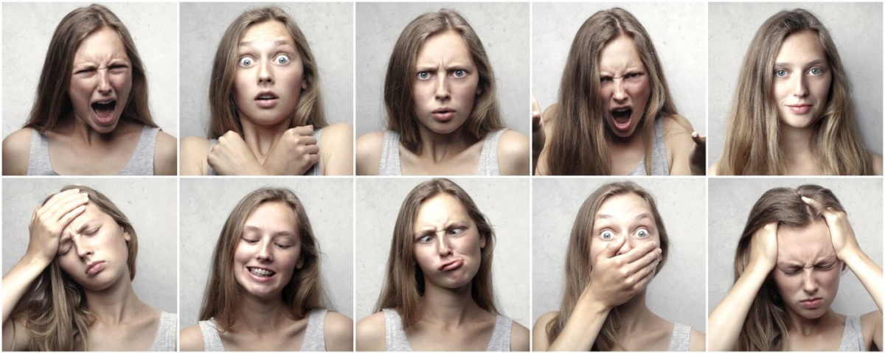
What is emotional regulation
The process of noticing, labeling and managing our emotions in response to situations and stimuli

Slide 4
What do we need to do it?
1. To interpret signals from the body that give clues about emotions and reflect on the situation we are in
2. To use words to name the emotion (even if just internally)
3. To have and use strategies to manage emotions in different situations

Slide 5
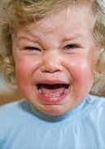
Challenges with this
Children (and adults) can have difficulties with one or all of these skills
Some children react in what appear to be disproportionate ways to situations which we might think do not warrant such big feelings

Slide 6
WHY is emotional regulation so difficult?
This can be linked to a special educational need such as ASC, ADHD or an Attachment difficulty
Early formative experiences
I would suggest that the prevalence of these difficulties is also linked to a changing experience of early childhood and the way in which regulation does or does not occur
For this final reason, we believe in this as a whole school approach and not only an intervention for targeted children – part of our Mental Health Strategy for the school.

Slide 7
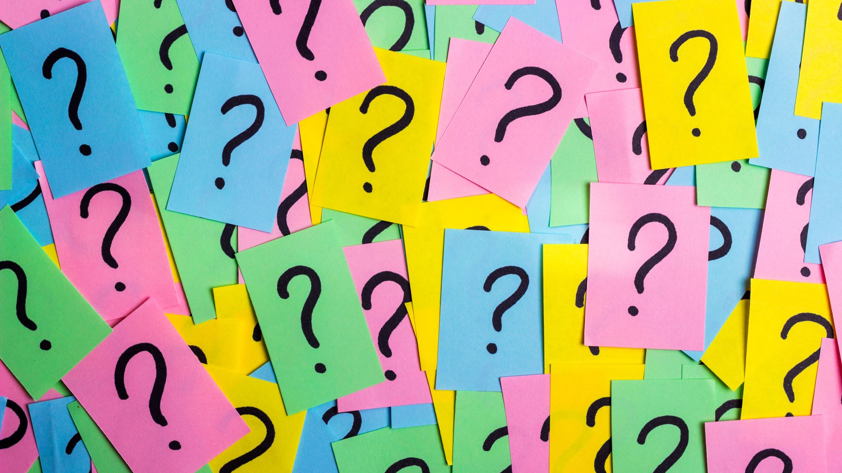
What are the zones…

Slide 8
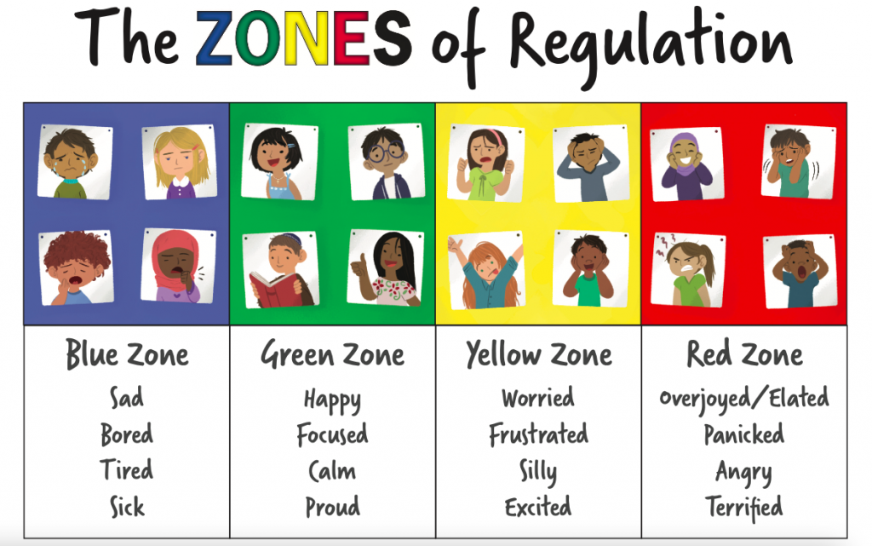

Slide 9
The Blue Zone is used to describe low states of alertness and down feelings.
Emotions in this zone may include when someone feels sad, tired, sick and bored.
The Green Zone is used to describe a calm sense of alertness.
Feelings in this zone include happy, focused, content and ready to learn.
The Yellow Zone is used to describe a heightened state of alertness and intense emotions. However, children experiencing yellow zone levels of alertness will feel more in control of their emotions than those feeling red zone emotions.
Emotions in this zone include stress, frustration, anxiety, excitement, silliness and nervousness.
The Red Zone is used to describe an extremely heightened sense of alertness and intense emotions.
The emotions in the red zone include anger, rage, devastation and fear.

Slide 10
Teaching about how to manage self regulation
Once the children have been introduced to the Zones of Regulation, it is important to support them in using these to make a difference to their own emotional regulation.
This is about direct teaching and ongoing modelling of self awareness, naming emotions to support development of emotional literacy, and adopting useful strategies for different zones.

Slide 11
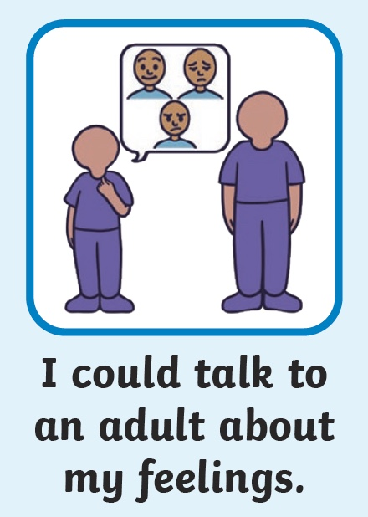
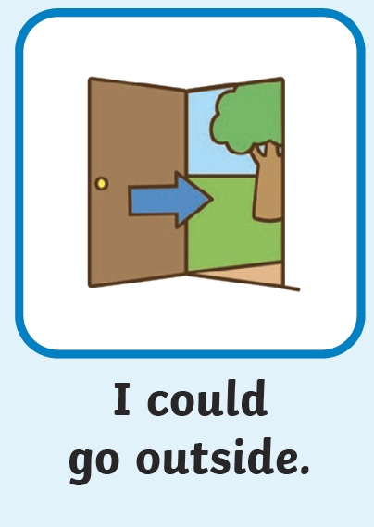
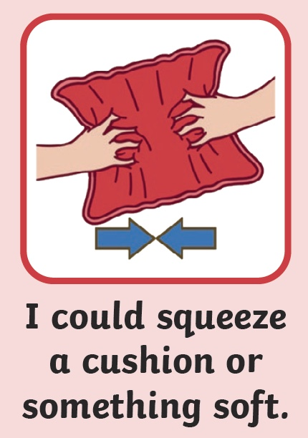
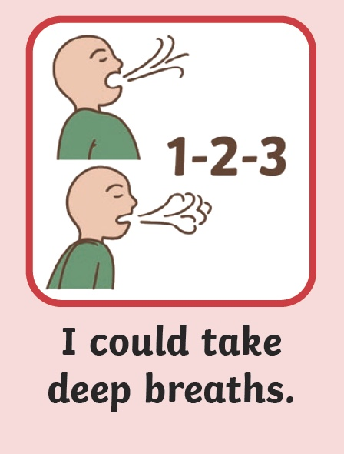
What Can I Do?
Use visuals and teach strategies for self regulation from each zone (in school, we also use our Jigsaw PSHE lesson!).
Build in deliberate practice of strategies for tricky zones e.g. breathing or grounding techniques.
Guide children to think about what helps – some children are calmed by reading/ colouring/ fidgets/ being given a job (‘heavy work’).

Slide 12
Be a role model
The simplest intervention is to be a role model - showing the children that each zone is normal and part of all human experience.
Share what you feel/ felt (within reason!), how you knew you were getting into that zone and use the language of emotions and the zones.
Talk about what you do/ did to help yourself manage your emotions.

Slide 13
Next steps
Feel free to take a Zones of Regulation handout!
Talk to your child about what they are beginning to know and understand about the zones
Talk to your child about strategies for times of big emotion – what helps?
There are lots of breathing exercises with videos, e.g. https://www.youtube.com/watch?v=7Ep5mKuRmAA, https://www.youtube.com/watch?v=KssedxpbLpg, https://www.youtube.com/watch?v=1XK35Vq_YFc, https://www.youtube.com/watch?v=EhZdehpfodQ

