Slide 1

L&F Positive Relationships Approach
New Policy – note the reference to relationships not just behaviour
The focus is on helping our young people to learn about positive relationships and behaviour, not just the traditional focus on managing and controlling behaviour.

Slide 2
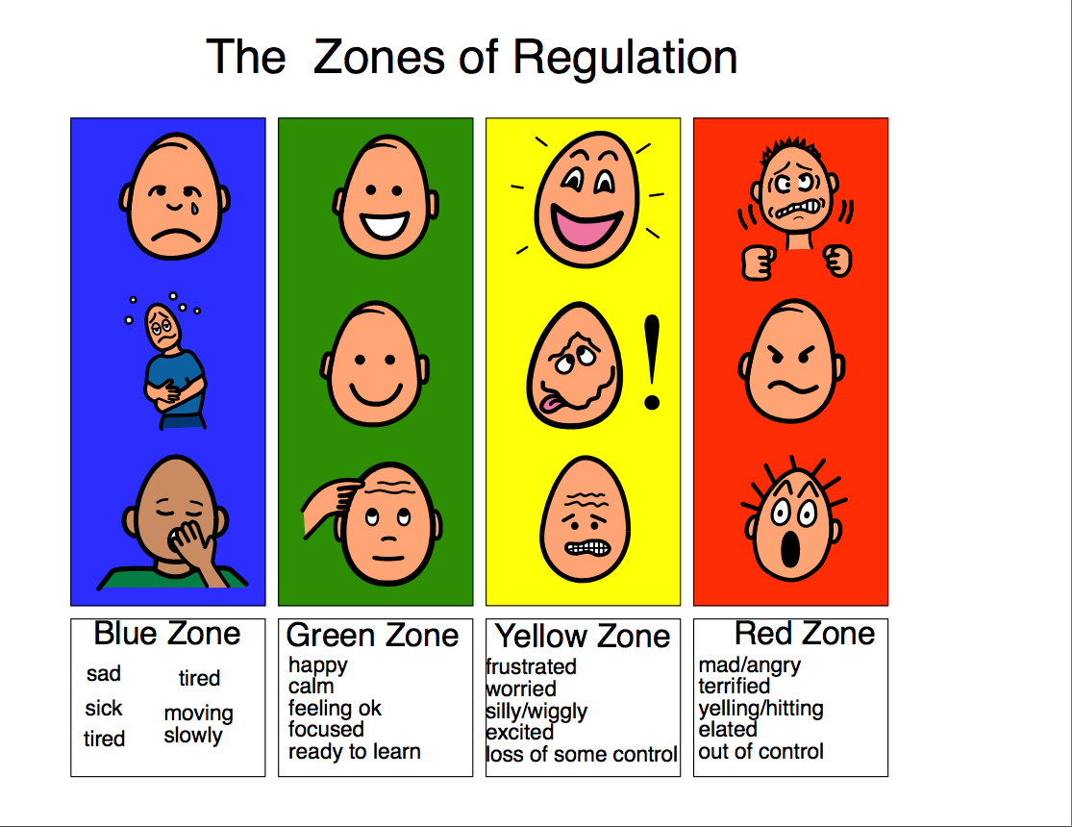
Supporting children’s relationships and behaviour starts with adult behaviour
Adults avoiding emotional responses or shouting (language, speed of reaction or body language)
Adults being realistic (length of time on the carpet, pitch of work, demands being made)
Adults providing a consistent role model for relationships and behaviour - talk about and recognise emotion, about how we manage it and respond to it
Adults teaching and supporting Co and Self-regulation – Zones of regulation
Children cannot regulate with sanctions!

Slide 3


First Attention to Best Conduct
Recognition first (more than reward) – smiles, notes, texts, high five, pat on the back, thumbs up, contact home etc.

Slide 4

Relentlessly bothered!
Investment in relationships
Three Values – Love, Honesty, Respect
Private stepped consequences

Slide 5

Scripts
Scripts for difficult interactions – No Freestyling!
Restorative practice – children get what they need
Key questions for restorative practice…
What were you feeling?
Who do you think might have been affected?
How do you think they felt?
What might we think about doing next?
Is there anything we could do differently in future?

Slide 6
